Slide 1

Heart Disease Prediction
Python project
Deployed with flask
Author – Nilay Modak

Slide 2
Executive Summary

Slide 3
Project Objectives
To analyze past data about heart disease patients to find patterns
To utilize some of those patterns to build a machine learning model.
Verifying the accuracy of the model and deploying it in a simple interactive format.

Slide 4
Benefits
Utilizing the model to predict the possibility of a heart disease early on and take preventive action.
This model can help save lives by providing critical information early on before the disease gets severe due to negligence.

Slide 5
1. Introduction

Slide 6
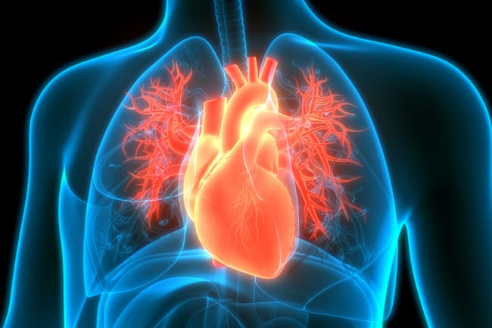
Heart Disease
Heart disease is any condition that affects the structure or function of the heart.
One person dies every 36 seconds in the United States from cardiovascular disease. About 659,000 people in the United States die from heart disease each year—that's 1 in every 4 deaths.
Heart disease costs the United States about $363 billion each year from 2016 to 2017.
Source: https://www.cdc.gov/heartdisease/facts.htm

Slide 7

Importance
Heart diseases are preventable.
Reversing negative effects with preventive action due to early awareness.
Usage of a machine learning model for predicting the presence of a heart disease.
Making the model accessible to people from all backgrounds.

Slide 8
2. Questions

Slide 9
Questions
Does the patient gender have any relation with their chance of developing a heart disease?
Does age play a role in the development of heart disease?
What are the most important factors according to machine learning algorithms?
Which Machine learning algorithm performs the best at predicting heart disease existence?

Slide 10
3. Data & Methodology

Slide 11
Data
Data was collected from a Kaggle dataset: LINK .
The data contains 1025 rows in total with 13 feature columns and 1 target variable.
Data was clean with minimal amount of obvious outliers in one of the columns(‘Chol’)
Overall the quality of the data was good.
Not much cleaning had to be done apart from correcting outliers.

Slide 12
Methodology
To develop the project I followed the typical machine learning development methodology which included the following steps:
Data Collection and importing
Data Analysis/EDA
Data Cleaning
Scaling Data
Building the models
Evaluating the models
Deploying the best performing model

Slide 13
Methodology
Below models were used to compare performances:
Logistic Regression
KNN Classification
Support Vector Classification
Naïve Bayes Classification
Decision Tree Classification
Random Forest Classification

Slide 14
4. Outcomes

Slide 15
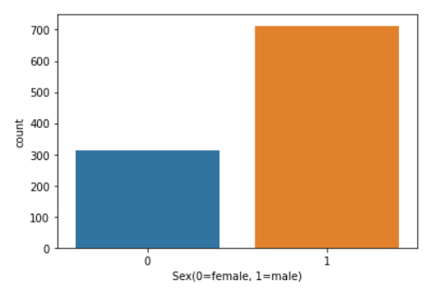
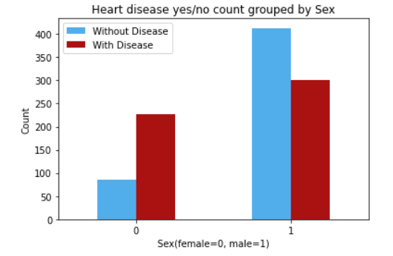
Question 1: Does the patient gender have any relation with their chance of developing a heart disease?
The number of female subjects in the study were much lower than the number of male subjects (fig 1).
However, a higher percentage of females had heart disease(fig 2).
Fig 1
Fig 2

Slide 16
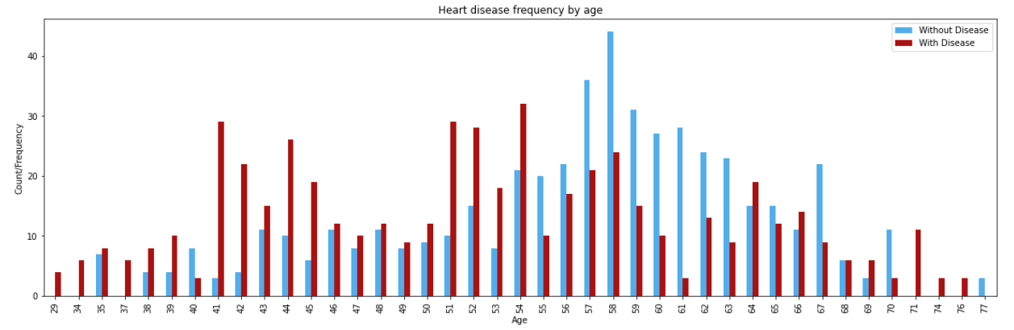
Question 2: Does age play a role in the development of heart disease?
Young adults have lower frequency of heart disease as opposed to older counterparts.
Highest frequency was observed in the people of ages 41-54.

Slide 17
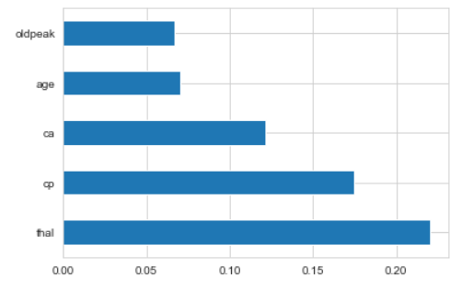
Question 3: What are the most important factors according to machine learning algorithms?
According to ExtraTreesClassifier:
Thal – Type of defect
Cp – Chest Pain
Ca – No of major vessels colored by fluoroscopy.
Age
Oldpeak – ST depression induced by exercise.

Slide 18
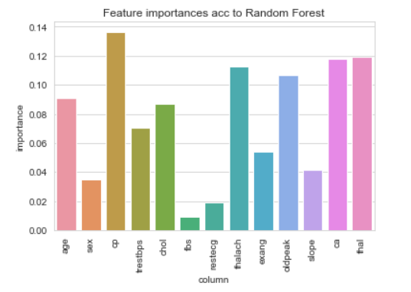
Question 3: What are the most important factors according to machine learning algorithms?
According to Random Forest Classifier:
Cp – Chest Pain
Thal – Type of defect
Ca – No of major vessels colored by fluoroscopy.
Thalach – maximum heart rate achieved
Oldpeak – ST depression induced by exercise.

Slide 19
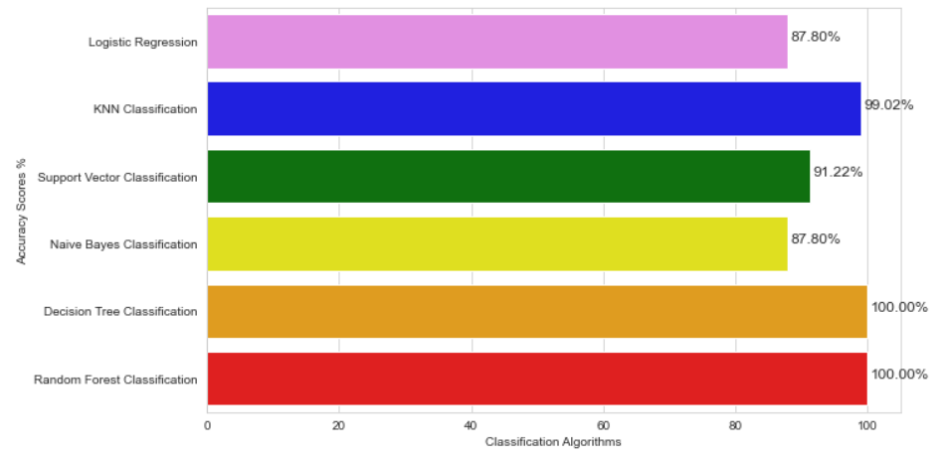
Question 4: Which Machine learning algorithm performs the best at predicting heart disease existence?
Random Forest Classification and Decision Tree Classification both provided 100% accuracy on the test/validation set.

Slide 20
5. Model Deployment

Slide 21
Deployment
Pickle is an inbuilt library in Python which allows us to convert Python objects to byte-stream data and vice versa.
Both the model and the scaler were exported as a pickle file using Pickle library. The pre-trained scaler was used to transform the input and the pre-trained model was used to make predictions.
The model was deployed using Flask library.
Flask is a micro web framework written in Python. It allows us to create an API like structure to allow us to communicate with our models.
Webpage form as input was designed for better accessibility for people without a programming background.

Slide 22
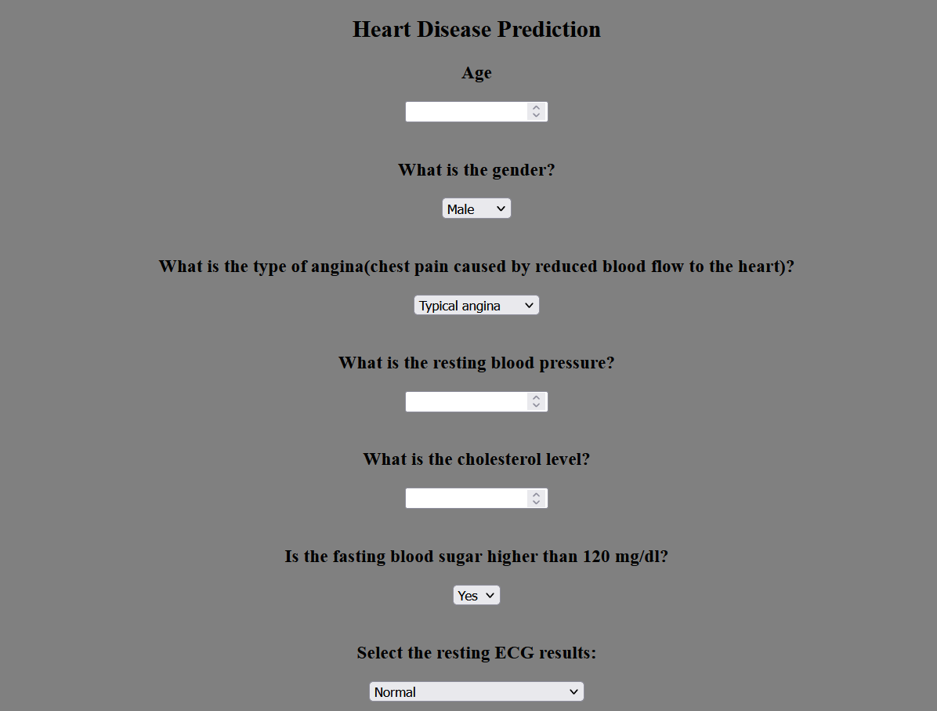
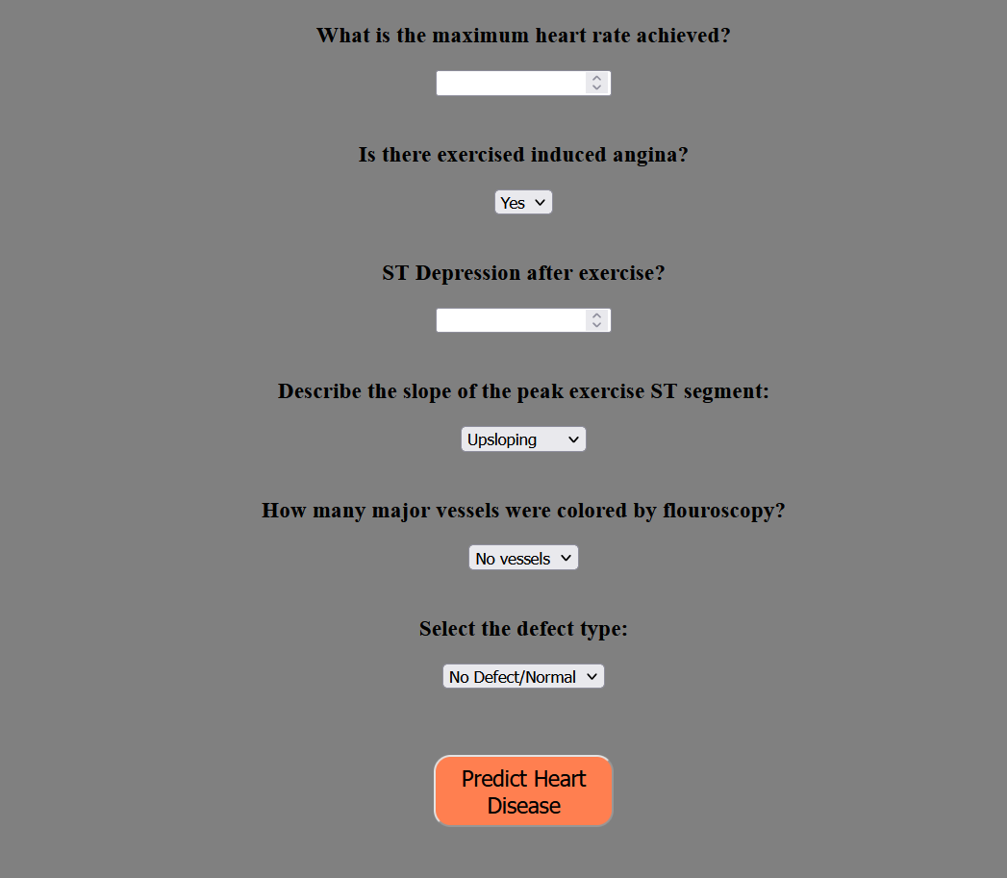
Webpage form to provide parameters
Part 1
Part 2

Slide 23
6. Conclusion

Slide 24
Conclusion
All the questions were answered.
All the project objectives were achieved.
Machine Learning model was developed with 100% test/validation accuracy. This model can now be used by people from variety of educational backgrounds because of a simple form input.
Presence of heart disease can be predicted and this can be used to help people with the risk of developing heart disease.
It will help in early prevention and might stop the disease from growing severe.

Slide 25
Thank you!

